Slide 1
嵌入式系統設計與實務
授課教師：逢甲大學 資訊工程系 陳德生老師、王益文老師

Slide 2
第 3 週
GPIO
3 - 1 GPIO pins to drive LEDs

Slide 3
Manual ： Nu-LB-NUC140_User_Mannaul_EN_Rev2.0.pdf
3
Notes:
sdfgdsfg

Slide 4
Manual：NUC140_Technical_Reference_Manual_EN_Rev2.05.pdf
4

Slide 5
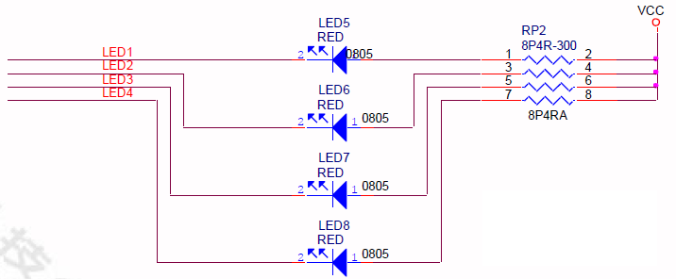

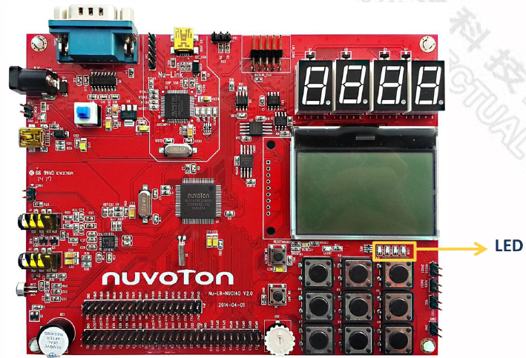
GPIO pins GPC12 - GPC15 to control 4 LEDs
5

Slide 6
C Codes : Library/StdDriver: gpio.c
GPIO_SetMode (GPIO_T *port, uint32_t u32PinMask, uint32_t u32Mode)
This function is used to set specified GPIO operation mode.
Parameters
[in] port GPIO port. It could be PA, PB, PC, PD, or PE.
[in] u32PinMask The single or multiple pins of specified GPIO port.
It is BIT0 ~ BIT15 for PA, PB, PC, PD and PE GPIO port.
[in] u32Mode Operation mode. . It could be
GPIO_PMD_INPUT,
GPIO_PMD_OUTPUT,
GPIO_PMD_OPEN_DRAIN,
GPIO_PMD_QUASI.
return None
6

Slide 7
Keil Demo
3

Slide 8
Practice 1 LED 學號二進位
顯示學號最後一碼的二進位
例 : 9 = 1001₍₂₎

Slide 9
Practice 2 LED 跑馬燈
由左向右跑的跑馬燈
1.
2.
3.
4.
5. Goto 1.

Slide 10
版權聲明
素材內容 | 引用來源 | 授權說明
PPT | https://drive.google.com/drive/folders/1dwAL_a18o_VV9iBkfLwzhcTKHnRy5K9S?usp=sharing 郭子仁 MCU Interfaces & Driver Design 2020

Slide 11

有著作權，侵害必究©逢甲大學
Copyright@Feng Chia University

